Slide 1
Dapp dSale
Jelena Đikić 1488

Slide 2
Napraviti Đapp dSale za oglašavanje prodaje privatnih stvari
Proučiti pametni ugovor Safe Remote Purchase https://solidity.readthedocs.io/en/v0.5.3/solidity-by-example.html#saferemote-purchase i projektovati pametni ugovor koji kreira i vodi evidenciju o kreiranim instancama pametnih ugovora za kupovinu proizvoda nalik ugovoru Safe Remote Purchase.
Obezbediti mogućnost kupca da ocenjuje prodavca samo u slučaju da je prodaja uspešna.
Đapp treba da omogući prodavcu da kreira pametni ugovor prodaje i da deponuje odgovarajući ulog.
Kupac prihvata ugovor i šalje svoj depozit. Kupovina-prodaja se odvija na način definisan u ugovoru iz primera.
Đapp mora da obezbedi listiranje aktivnih prodaja i kupovina-prodaja koje su završene kao i mogućnost prikaza ocena prodavaca

Slide 3
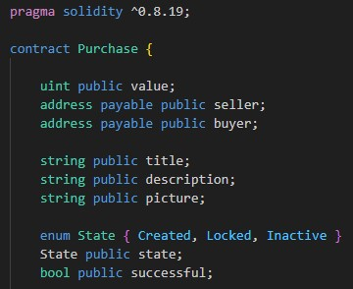
Purchase contract

Slide 4
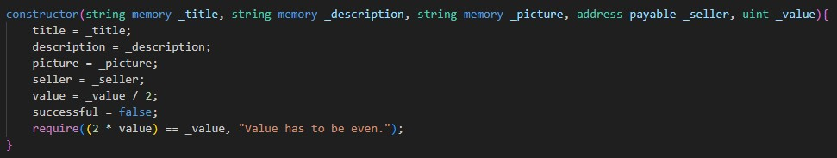
Purchase contract
konstruktor

Slide 5
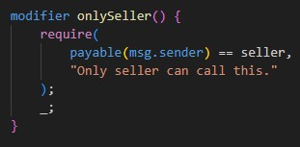
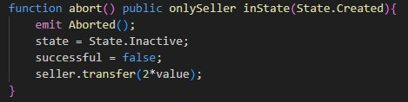
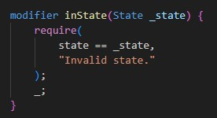
Purchase contract
abort

Slide 6
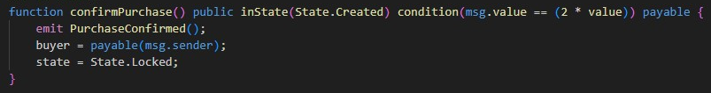
Purchase contract
Confirm purchase

Slide 7
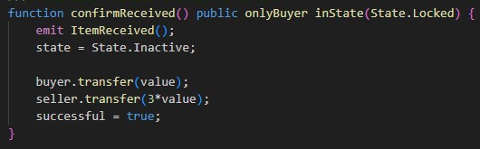
Purchase contract
Confirm Received

Slide 8
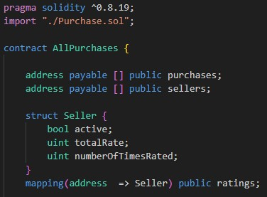
Factory contract - AllPurchases

Slide 9
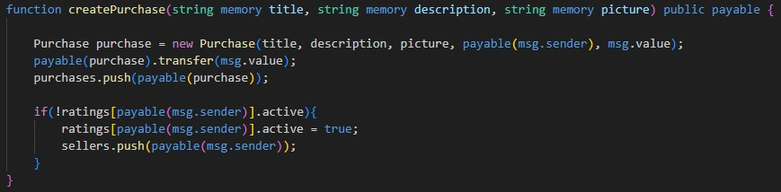
Factory contract - AllPurchases
createPurchase

Slide 10
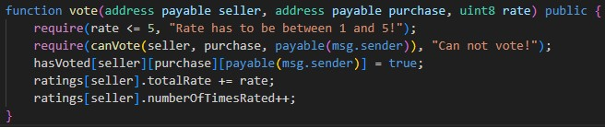
Factory contract - AllPurchases
vote

Slide 11
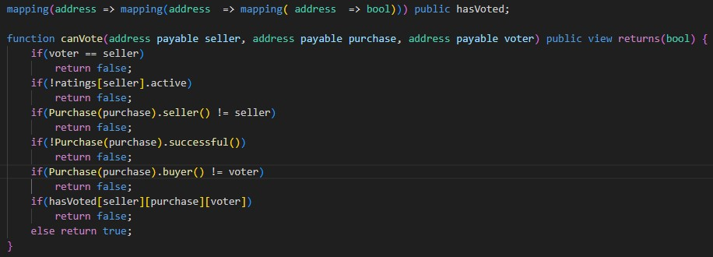
Factory contract - AllPurchases
canVote

Slide 12

Application - video

Slide 13
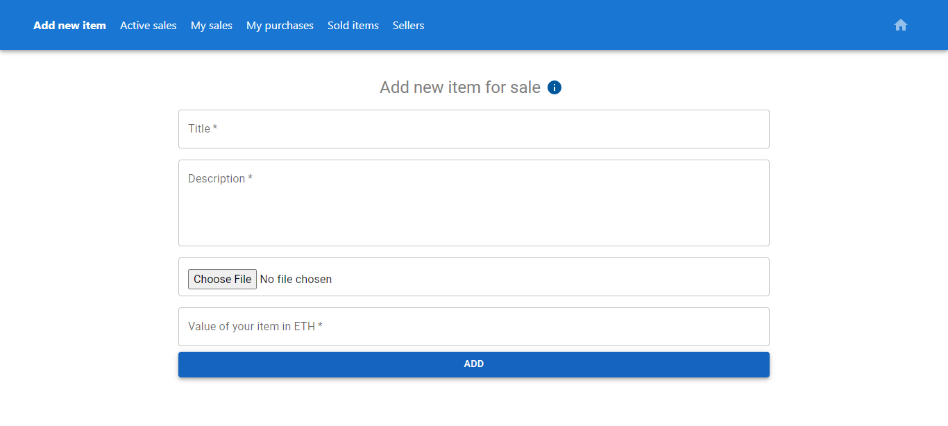
Adding new item

Slide 14
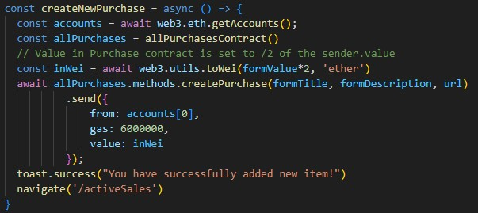
Adding new item
createPurchase

Slide 15
Adding new item - video

Slide 16
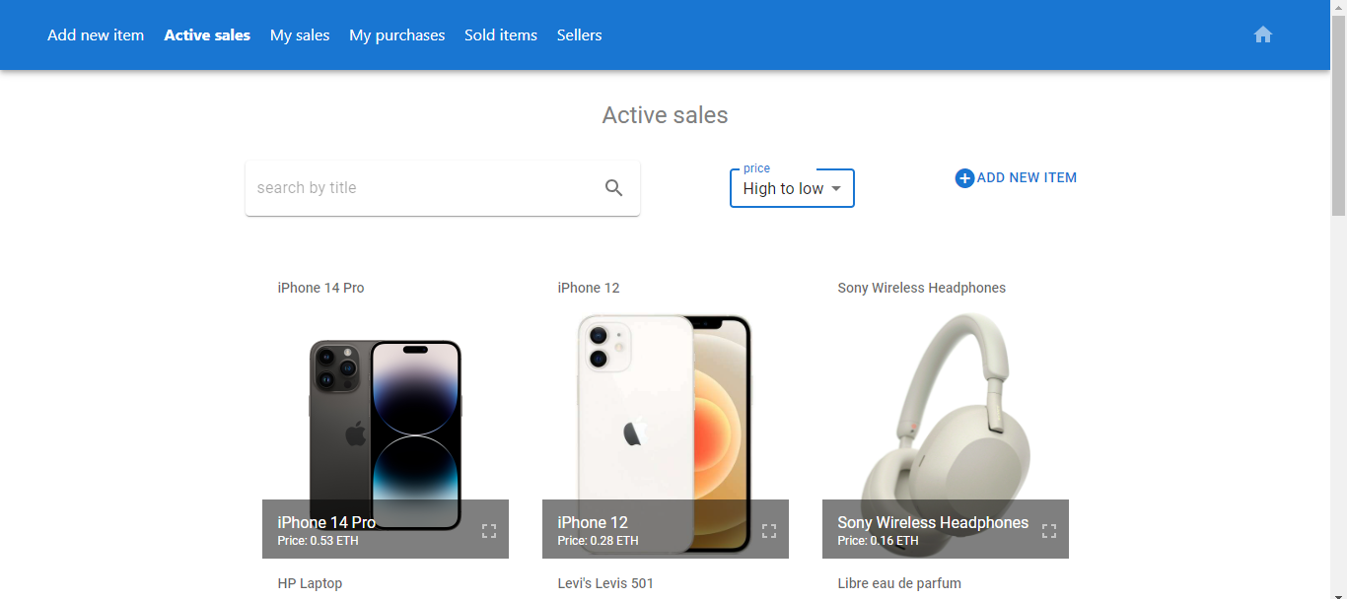
Active sales

Slide 17
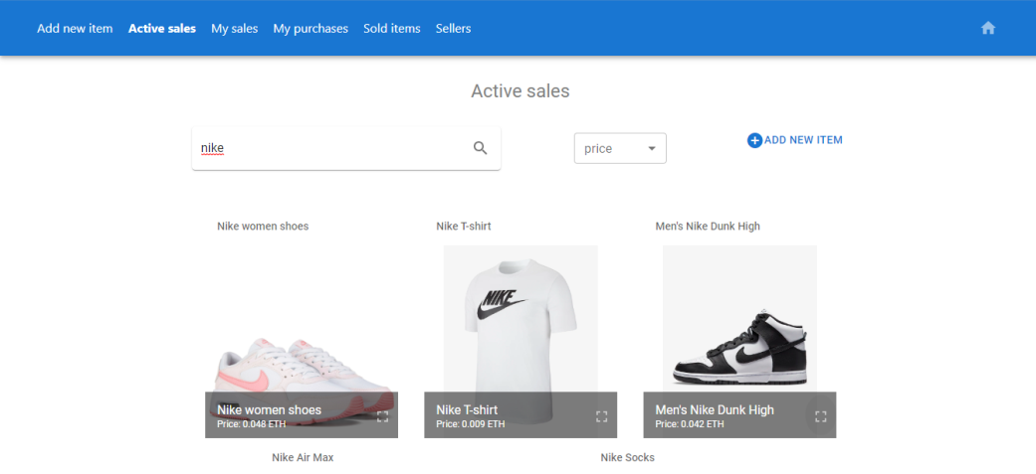
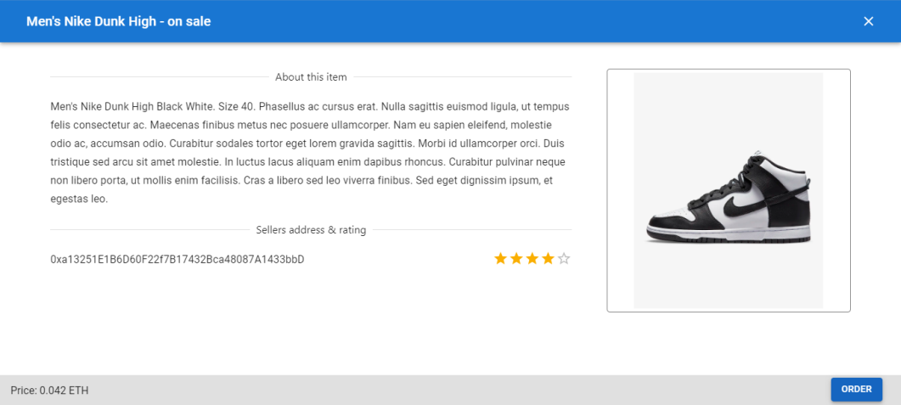
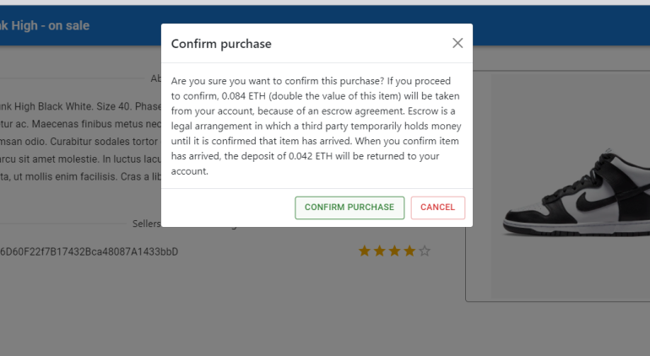
Ordering an item
1
2
3

Slide 18
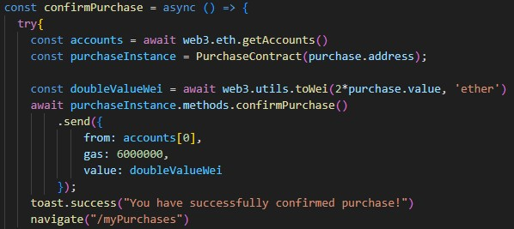
Ordering an item

Slide 19
Ordering an item - video

Slide 20
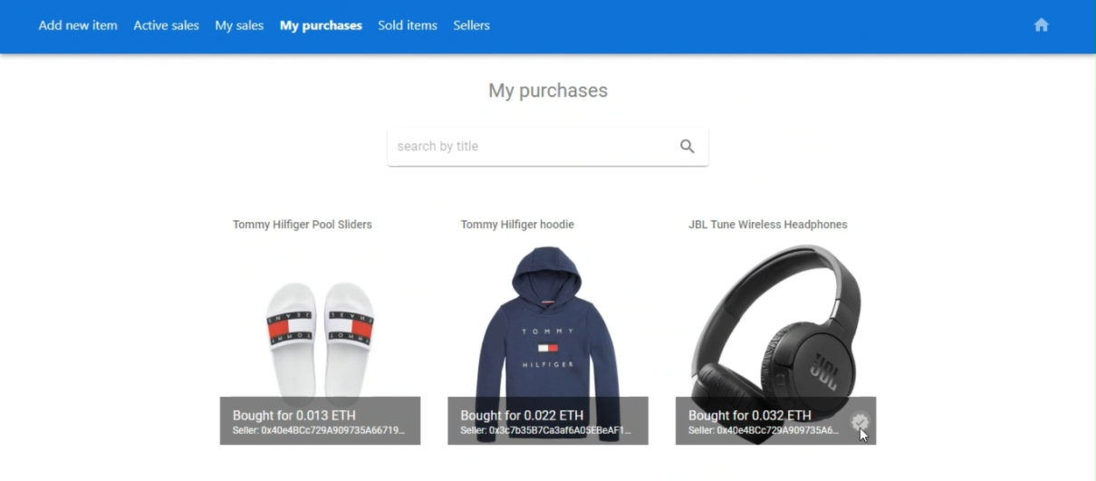
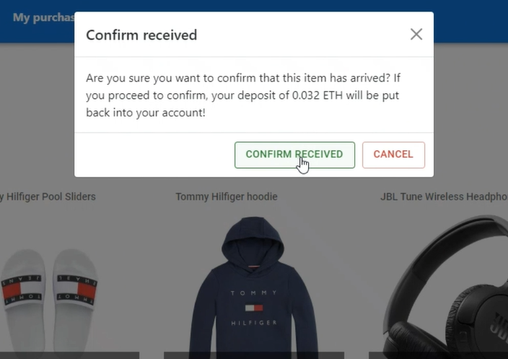
Confirming that item has arrived

Slide 21
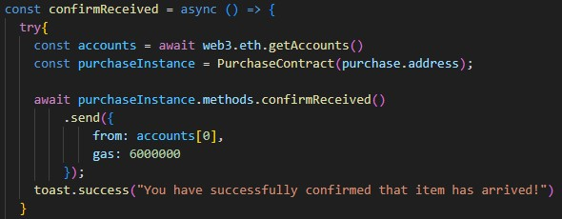
Confirming that item has arrived

Slide 22
Confirming that item has arrived - video

Slide 23

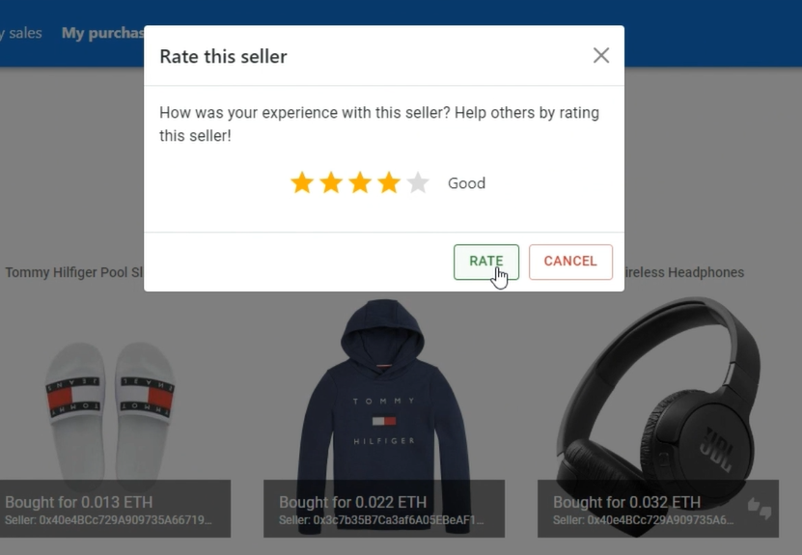
Rating the seller

Slide 24
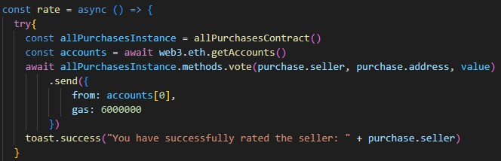
Rating the seller

Slide 25
Rating the seller - video

Slide 26
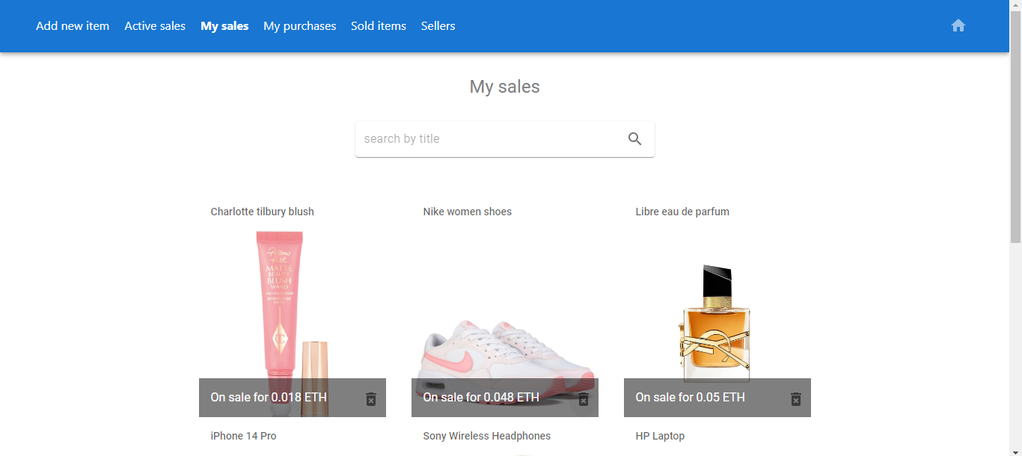
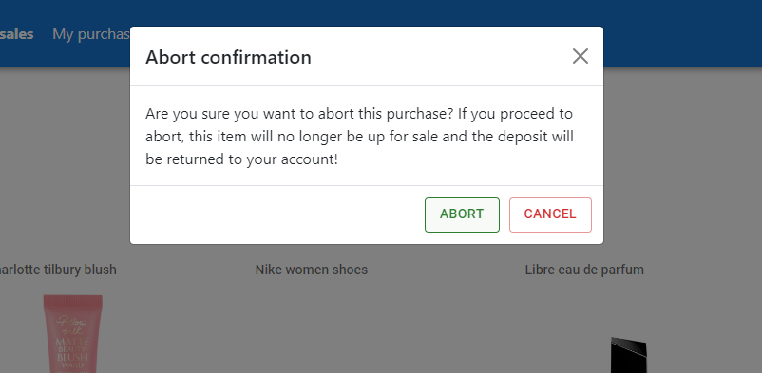
Aborting purchase

Slide 27
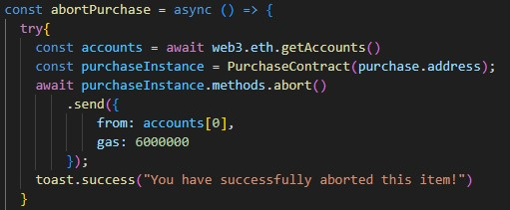
Aborting purchase

Slide 28
Aborting purchase - video

Slide 29
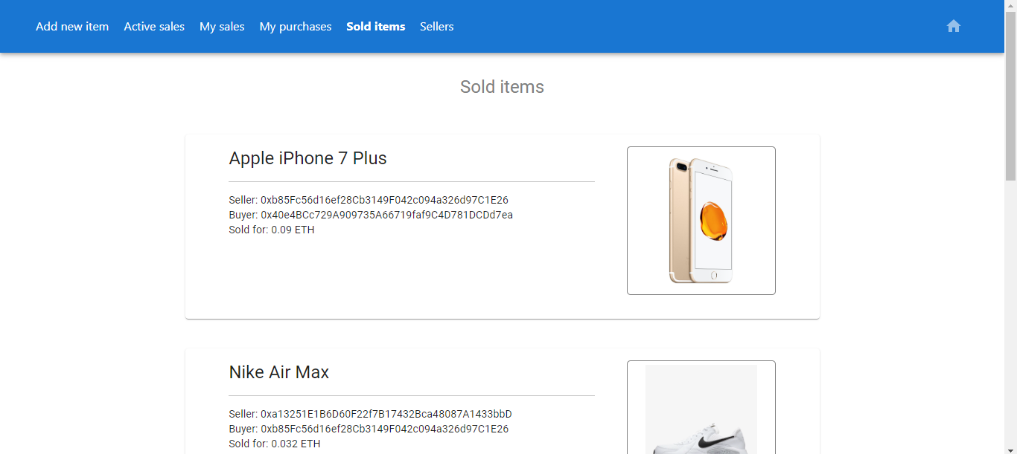
Sold items

Slide 30
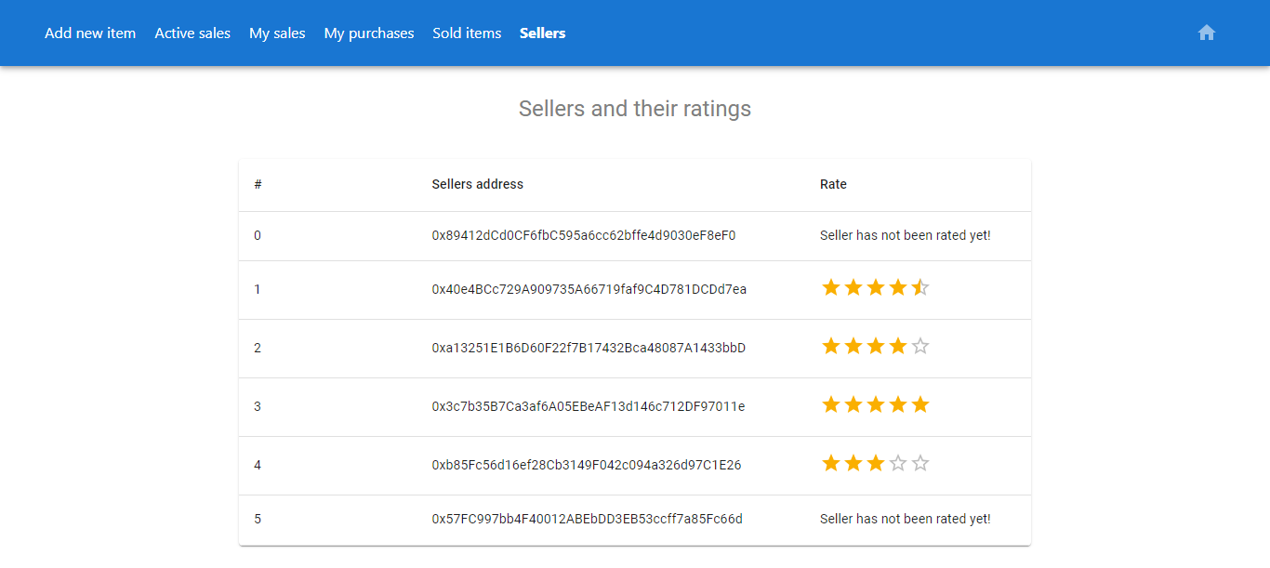
Sellers and their ratings

Slide 31
Hvala na pažnji!

